Slide 1
Sampling Distributions for Small Samples
Paul Kinion and Dustin Haxton

Slide 2
On a scale from 1 (easy) to 5 (hard) rate the difficulty in teaching the concept of sampling distributions.

Slide 3
Demonstration of Sampling Distributions

Slide 4
Triola

Slide 5
Khan Academy

Slide 6
Online Statbook

Slide 7
Online Statbook

Slide 8
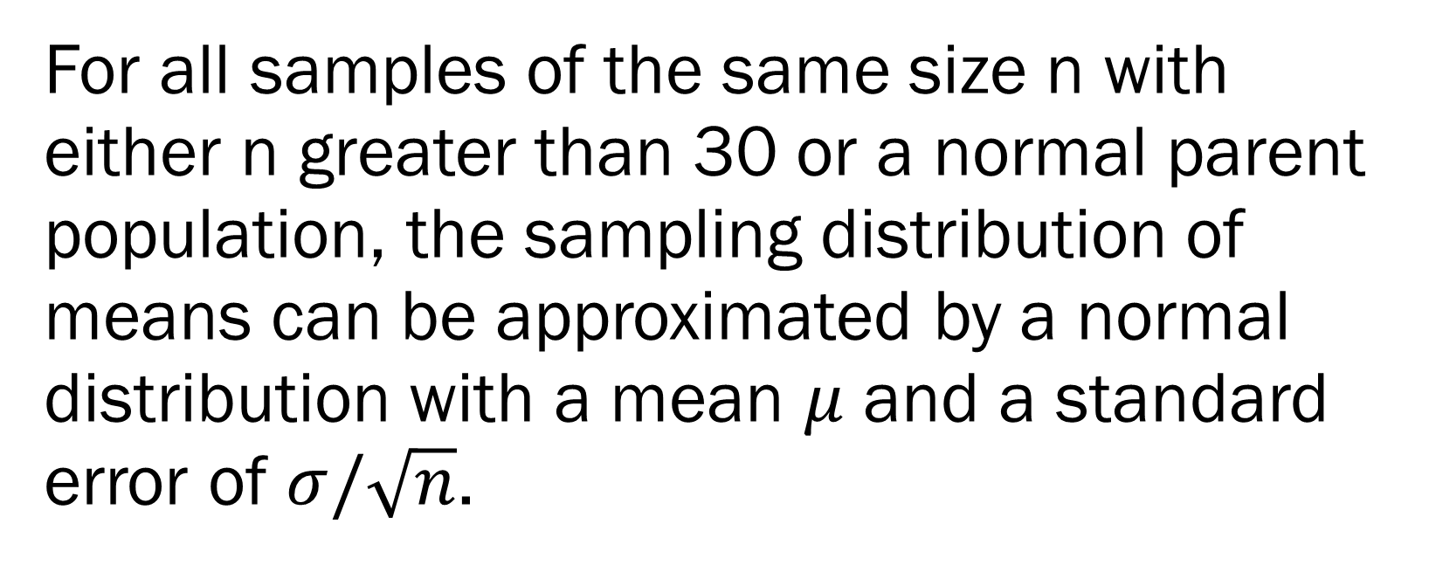
Central Limit Theorem
For all samples of the same size n with either n greater than 30 or a normal parent population, the sampling distribution of means can be approximated by a normal distribution with a mean $μ$ and a standard error of $σ/\sqrt{n}$.

Slide 9
Wikipedia
Tijms writes:[38]
The central limit theorem has an interesting history. The first version of this theorem was postulated by the French-born mathematician Abraham de Moivre who, in a remarkable article published in 1733, used the normal distribution to approximate the distribution of the number of heads resulting from many tosses of a fair coin. This finding was far ahead of its time, and was nearly forgotten until the famous French mathematician Pierre-Simon Laplace rescued it from obscurity in his monumental work Théorie analytique des probabilités, which was published in 1812. Laplace expanded De Moivre's finding by approximating the binomial distribution with the normal distribution. But as with De Moivre, Laplace's finding received little attention in his own time. It was not until the nineteenth century was at an end that the importance of the central limit theorem was discerned, when, in 1901, Russian mathematician Aleksandr Lyapunov defined it in general terms and proved precisely how it worked mathematically. Nowadays, the central limit theorem is considered to be the unofficial sovereign of probability theory.

Slide 10
Demonstration of Central Limit Theorem (n>30)

Slide 11
Demonstration of Central Limit Theorem (normal parent population)

Slide 12
Combinatorics Tree

Slide 13
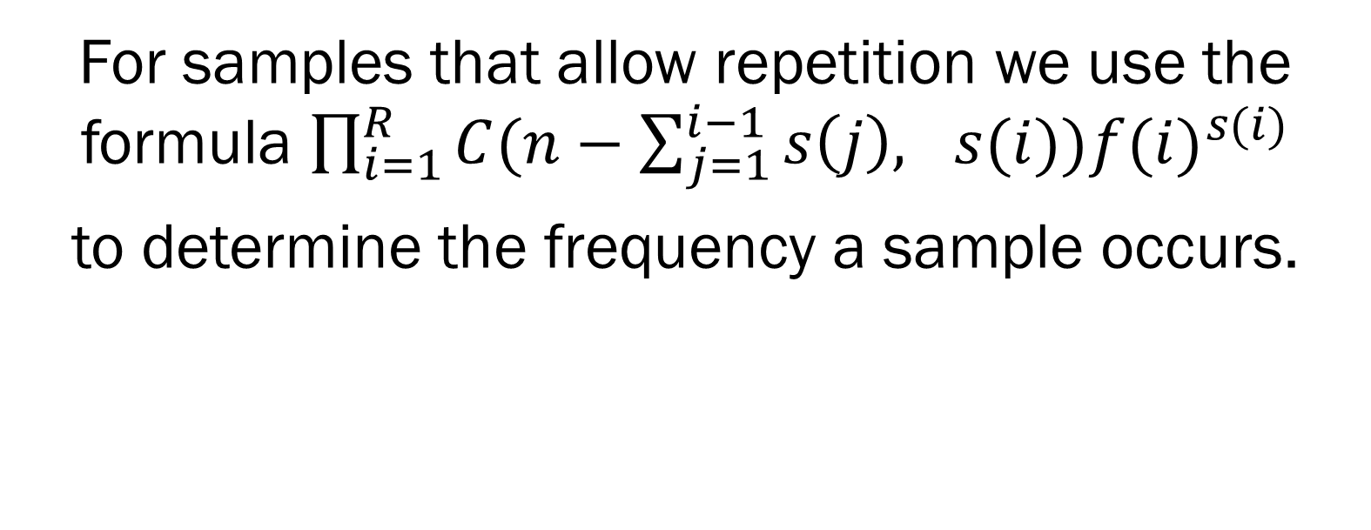
Frequencies
For samples that allow repetition we use the formula $\prod_{i=1}^{R}{C(n−\sum_{j=1}^{i−1}{s\left(j\right), s(i)){f(i)}^{s(i)}}}$
to determine the frequency a sample occurs.

Slide 14
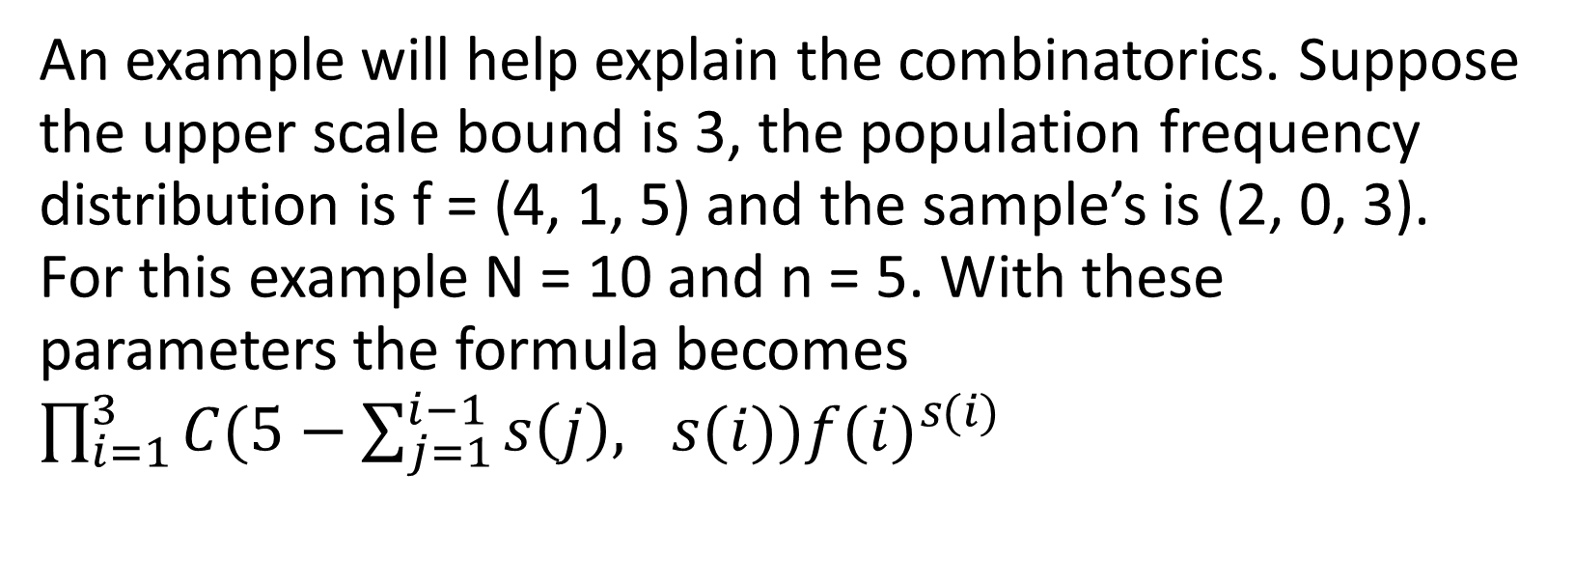
Example
An example will help explain the combinatorics. Suppose the upper scale bound is 3, the population frequency distribution is f = (4, 1, 5) and the sample’s is (2, 0, 3). For this example N = 10 and n = 5. With these parameters the formula becomes $\prod_{i=1}^{3}{C(5−\sum_{j=1}^{i−1}{s\left(j\right), s(i)){f(i)}^{s(i)}}}$

Slide 15
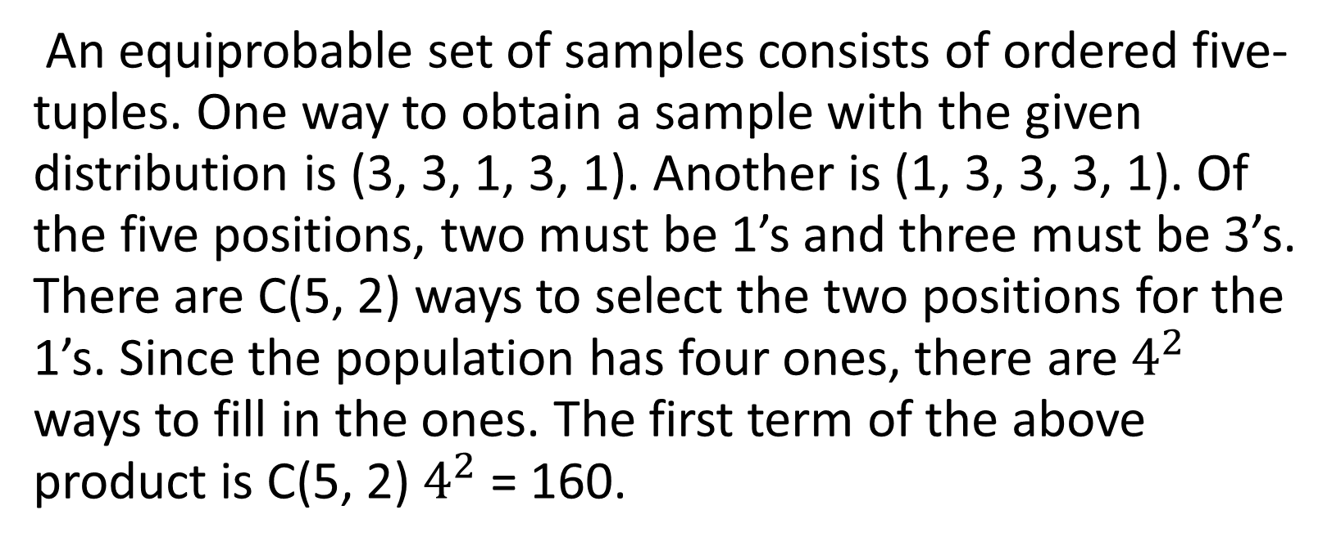
Example Continued
An equiprobable set of samples consists of ordered five-tuples. One way to obtain a sample with the given distribution is (3, 3, 1, 3, 1). Another is (1, 3, 3, 3, 1). Of the five positions, two must be 1’s and three must be 3’s. There are C(5, 2) ways to select the two positions for the 1’s. Since the population has four ones, there are $4^{2}$ ways to fill in the ones. The first term of the above product is C(5, 2)$4^{2}$ = 160.

Slide 16
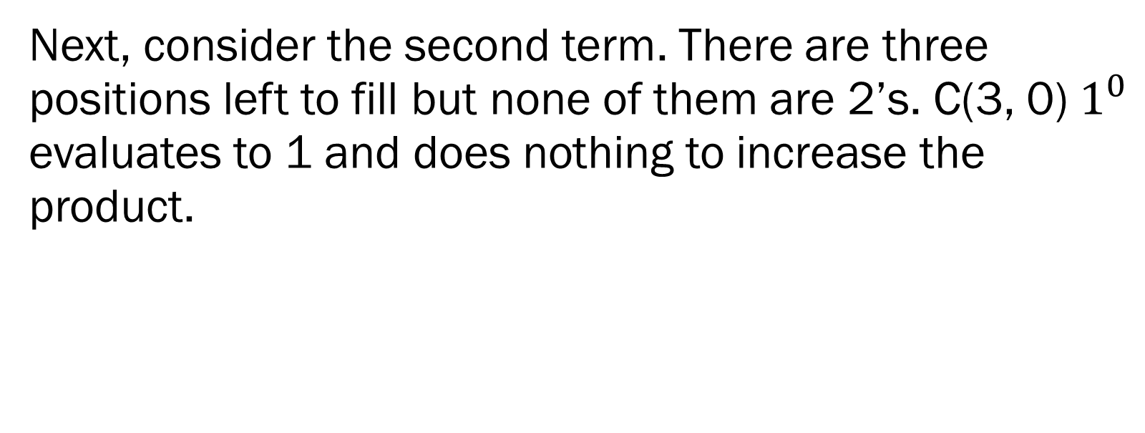
Example Continued
Next, consider the second term. There are three positions left to fill but none of them are 2’s. C(3, 0)$1^{0}$ evaluates to 1 and does nothing to increase the product.

Slide 17

Example Continued
The third term is C(3, 3)$5^{3}$ = 125. It represents the fact that the remaining three positions must be 3’s and that there are five options for each 3.

Slide 18
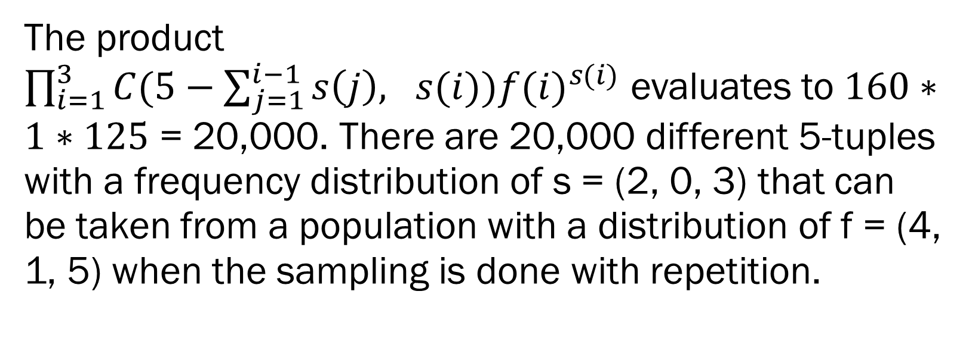
Example Continued
The product
$\prod_{i=1}^{3}{C(5−\sum_{j=1}^{i−1}{s\left(j\right), s(i)){f(i)}^{s(i)}}}$ evaluates to $160∗1∗125$ = 20,000. There are 20,000 different 5-tuples with a frequency distribution of s = (2, 0, 3) that can be taken from a population with a distribution of f = (4, 1, 5) when the sampling is done with repetition.

Slide 19
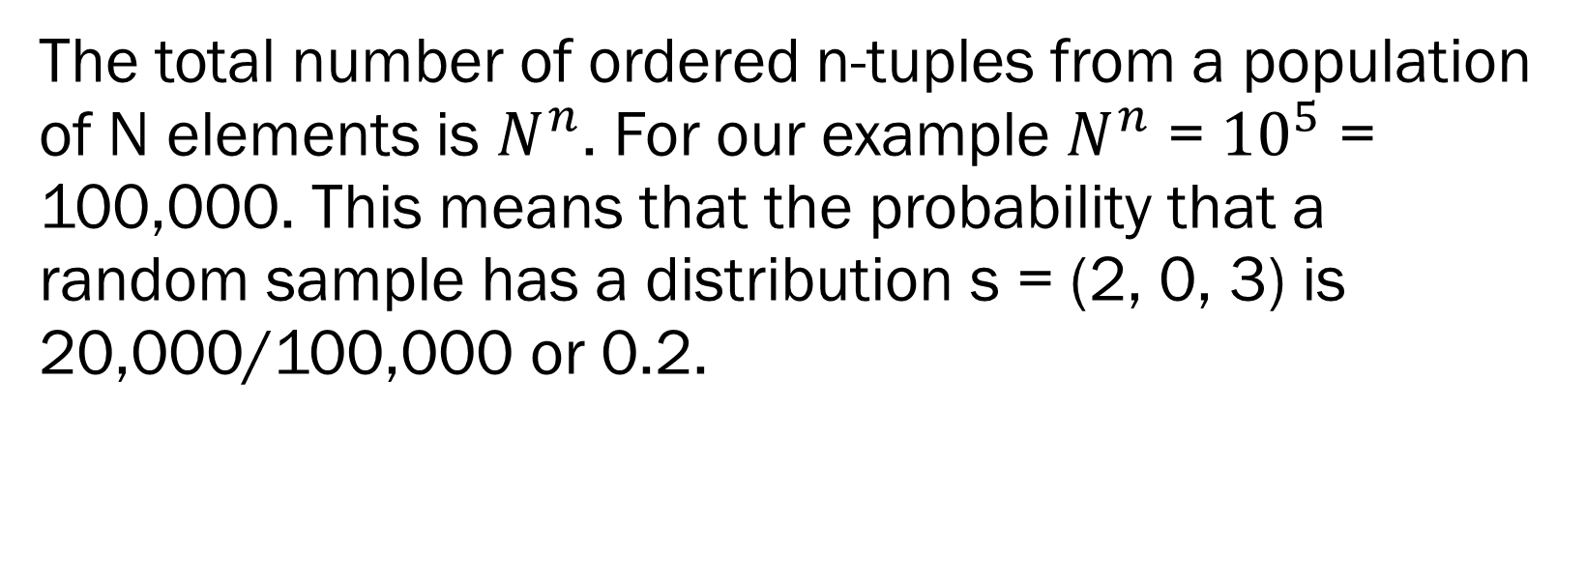
Example Finished
The total number of ordered n-tuples from a population of N elements is $N^{n}$. For our example $N^{n}$ = ${10}^{5}$ = 100,000. This means that the probability that a random sample has a distribution s = (2, 0, 3) is 20,000/100,000 or 0.2.

Slide 20
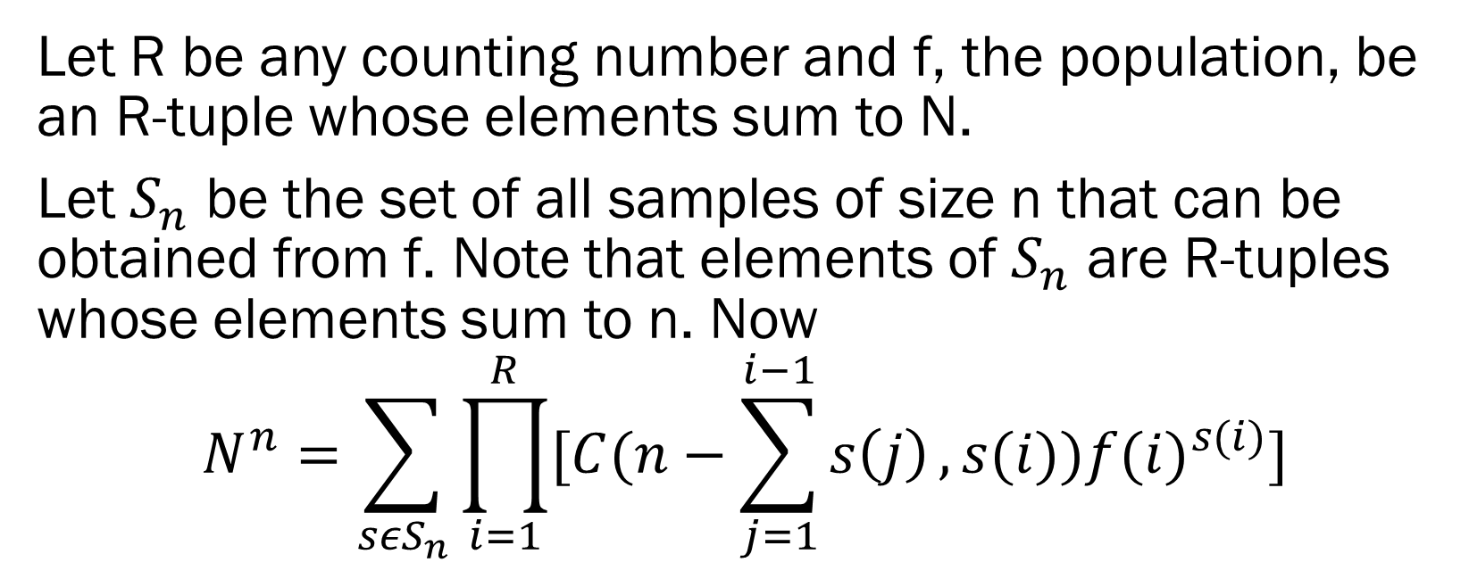
Exponentiation Theorem
Let R be any counting number and f, the population, be an R-tuple whose elements sum to N.
Let $S_{n}$ be the set of all samples of size n that can be obtained from f. Note that elements of $S_{n}$ are R-tuples whose elements sum to n. Now
$$N^{n}=\sum_{{sεS}_{n}}{\prod_{i=1}^{R}{[C(n−\sum_{j=1}^{i−1}{s\left(j\right)},s(i)){f(i)}^{s(i)}]}}$$

Slide 28
Stat Trek
Sampling Distributions
Suppose that we draw all possible samples of size n from a given population. Suppose further that we compute a statistic (e.g., a mean, proportion, standard deviation) for each sample. The probability distribution of this statistic is called a sampling distribution. And the standard deviation of this statistic is called the standard error.
Variability of a Sampling Distribution
The variability of a sampling distribution is measured by its variance or its standard deviation. The variability of a sampling distribution depends on three factors:
N: The number of observations in the population.
n: The number of observations in the sample.
The way that the random sample is chosen.
If the population size is much larger than the sample size, then the sampling distribution has roughly the same standard error, whether we sample with or without replacement. On the other hand, if the sample represents a significant fraction (say, 1/20) of the population size, the standard error will be meaningfully smaller, when we sample without replacement.

Slide 29
Stat Trek
Sampling Distribution of the Mean
Suppose we draw all possible samples of size n from a population of size N. Suppose further that we compute a mean score for each sample. In this way, we create a sampling distribution of the mean.
We know the following about the sampling distribution of the mean. The mean of the sampling distribution (μ_{x}) is equal to the mean of the population (μ). And the standard error of the sampling distribution (σ_{x}) is determined by the standard deviation of the population (σ), the population size (N), and the sample size (n). These relationships are shown in the equations below:
μ_{x} = μ and σ_{x} = [ σ / sqrt(n) ] * sqrt[ (N - n ) / (N - 1) ]
In the standard error formula, the factor sqrt[ (N - n ) / (N - 1) ] is called the finite population correction or fpc. When the population size is very large relative to the sample size, the fpc is approximately equal to one; and the standard error formula can be approximated by:
σ_{x} = σ / sqrt(n).
You often see this "approximate" formula in introductory statistics texts. As a general rule, it is safe to use the approximate formula when the sample size is no bigger than 1/20 of the population size.

Slide 30
Finite Population Correction
μ_{x} = μ
and
σ_{x} = [ σ / sqrt(n) ] * sqrt[ (N - n ) / (N - 1) ]
σ_{x} = σ / sqrt(n)

Slide 31
References
Elementary Statistics by Mario F Triola, 12th edition, Pearson
https://www.khanacademy.org/math/probability/statistics-inferential/sampling_distribution/v/sampling-distribution-of-the-sample-mean
http://onlinestatbook.com/stat_sim/sampling_dist/
https://en.wikipedia.org/wiki/Central_limit_theorem
Henk, Tijms (2004), Understanding Probability: Chance Rules in Everyday Life, Cambridge: Cambridge University Press, p. 169, ISBN 0-521-54036-4
http://stattrek.com/sampling/sampling-distribution.aspx
http://www.rctc.edu/academics/math/sdss.html

